Slide 1

Nencki Institute of Experimental Biology PAS
Founded in 1918
Location: Warsaw, Poland
www.nencki.gov.pl

Slide 2
General information
The largest non-university center for biological research in Poland
Structure: 5 Departaments: Cell Biology, Biochemistry, Molecular and Cellular Neurobiology, Neurophysiology, Neurobiology Center
43 research labs (including Animal House and services labs)
Over 250 scientists from Poland and foreigners (India, England, Ukraine, Romania, Iran)
150 doctoral students (from Poland and foreigners: India, Hungary, Ukraine, China)

Slide 3
General Information
Research grants from sources Polish Ministry of Science and Higher Education and funds from the European Union
Well-equipped laboratories with the latest equipment (e.g. microscopes, tomograph)
Cooperation with foreign partners
Publishing achievements
Awards and prizes
Popularization of science
Social Media

Slide 4
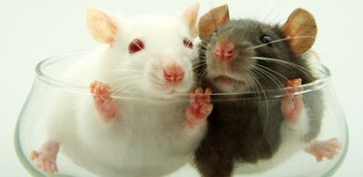
Animal House
Provides animals (mouses and rats) for experiments (selected according to age, sex, weight, and phase of the cycle) at the laboratories of the Nencki Institute
Our animals periodically undergo pathological, parasitological, bacteriological and virusological control
Divided into separate areas for breeding and experimental purposes

Slide 5
Doctoral Studies - PhD
Duration: Four yrs with the posiibility of extension (two yrs)
Language: Polish or English
Participation in prestigious research
Experiments using the latest equipment
International Exchange: Erasmus +, conferences, trainings
International studies: NeuroPHD (2009-2014), Bio4med (start 2015, funded Horizon2020)
Cooperation with other universities outside the strictly biological sciences
Prize

Slide 6
Doctoral Studies - PhD
The recruitment is performed in three stages:
Submit the required documents (on-line), select research project
Recruitment Committee assesses the candidates
Interviews with candidates and voting

Slide 7

NeuroPhD (2009-2014)
International PhD program in neurobiology
Collaborative PhD projects between The Nencki Institute and International Partners
17 PhD projects avaliabed in all the major areas of neuroscience
Extensive visit(s) to foreign partner laboratory (6-24 months)
Multidisciplinary training
Stipend 3500-5000 PLN/month (900-1200 Euro/month)
http://neurophd.nencki.gov.pl/

Slide 8

Bio4Med (2015 -2020)
International PhD Program in Biological Bases of Human Diseases
Collaborative PhD projects between The Nencki Institute and International Partners
14 PhD projects availabled
Visit(s) to foreign partner laboratory
Multidisciplinary training
Stipend 1700 Euro/month
Start date October 2015
Candidates for Bio4Med International PhD Program must not have resided or carried out their main activity (work, studies, etc.) in Poland for more than 12 months in the past 3 years.
http://studia.nencki.gov.pl/?a=bio4med

Slide 9

Bio-Imagine (2011-2014)
BIO-IMAGing in research INnovation and Education (supported by the EU FP7Capacities Programme)
Recruitment
Conferences and worskhops
Innovation and technology transfer
Popularization of science
http://bioimagine.nencki.gov.pl

Slide 10
Erasmus+ (2014-2020)
The Institute received the card Erasmus for 2014-2020
A trip within the Erasmus+ may apply to each participant PhD (excluding freshmen) or employee, regardless of nationality
e.g. Radboud University, University of Bari, Norwegian University of Life Sciences

Slide 11

Award:
HR Excellence in Research
First Polish research institution which complied with the guidelines of the European Charter for Researchers and the Code of Conduct for the Recruitment of Researchers
In May 2015 the Nencki Institute prepared a report which has received a positive opinion from the Commission.

Slide 12







Recruitment of scientists
POST-DOC offerts
international reach recruitment (avaliable on english languages websites)
assistance in completing the formalities for the legalization stay and work in Poland

Slide 13
Popularization of Science
EMBO Young Scientists Forum
4th International Symposium „Behavioural mechanisms in animals and options of their modelling
3rd Baltic Stem Cell Meeting at the Nencki Institute
Symposium „Biological roots of altruism and pro-social behaviour”
XIII Scientific Meeting for Teachers
Congress BIO 2014
The 18th Warsaw Science Festival at the Nencki Institute

Slide 14
Incoming conferences
44th European Muscle Conference will be held in Warsaw from September 21 to September 25, 2015. The main theme of the Conference is Muscle Research in Health and Disease
http://www.emc2015.org.pl/
The scientific programme covers: Acto-Myosin Interactions; Excitation-Contraction Coupling; Heart and Heart Failure; Molecular Motors; Muscle Cytoskeleton; Muscle Development and Repair; Muscle Exercise and Plasticity; Muscle Metabolism and Bioenergetics; Neuromuscular Interactions; Skeletal Muscle Diseases and Smooth Muscle in Health and Disease.
The Organizers:
Nencki Institute of Experimental Biology
Polish Biochemical Society
Kazimierz Wielki University, Faculty of Natural Science Bydgoszcz
University of Warsaw Faculty of Biology
Department of Neurology, Warsaw Medical University

Slide 15

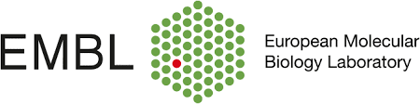


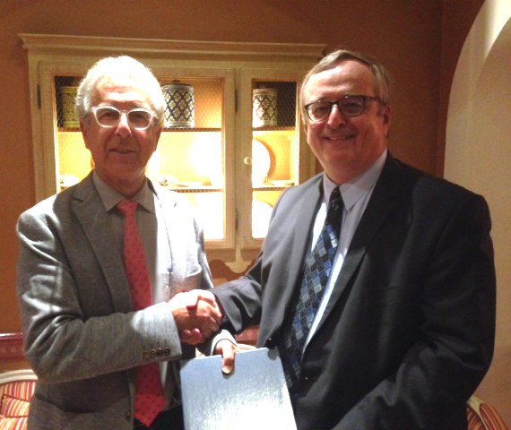

Latest long-term international relations

Slide 16
Movie

Slide 17
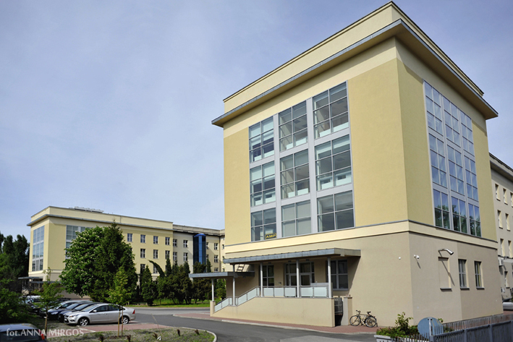
Contact
Nencki Institute of Experimental Biology
Polish Academy of Sciences
3 Pasteur Street
02-093 Warszawa
Poland
Director of the Institute: Adam Szewczyk
phone: (48 22) 5892207
fax: (48 22) 822 53 42
e-mail: dyrekcja@nencki.gov.pl
International Cooperation
Office of International Cooperation and Project Management
Head: Anna Sadlik-Paskalec
phone: (48 22) 5892263
fax: (48 22) 668 65 86
e-mail: a.sadlik@nencki.gov.pl

Slide 18
Thank you very much for your attention

